Slide 1
Two possible radical structures
after sulfur treatment

Slide 2
Carbon radical and sulfur radical anions

Slide 3
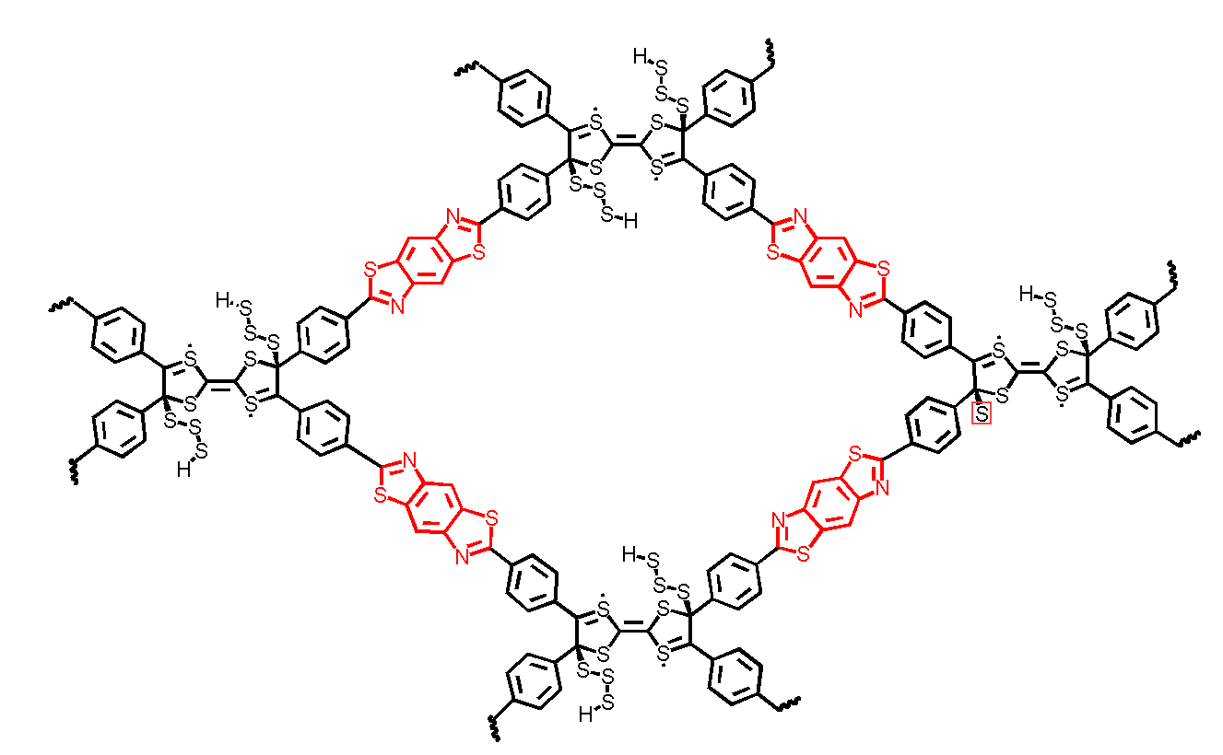
Sulfur radical

